Slide 1
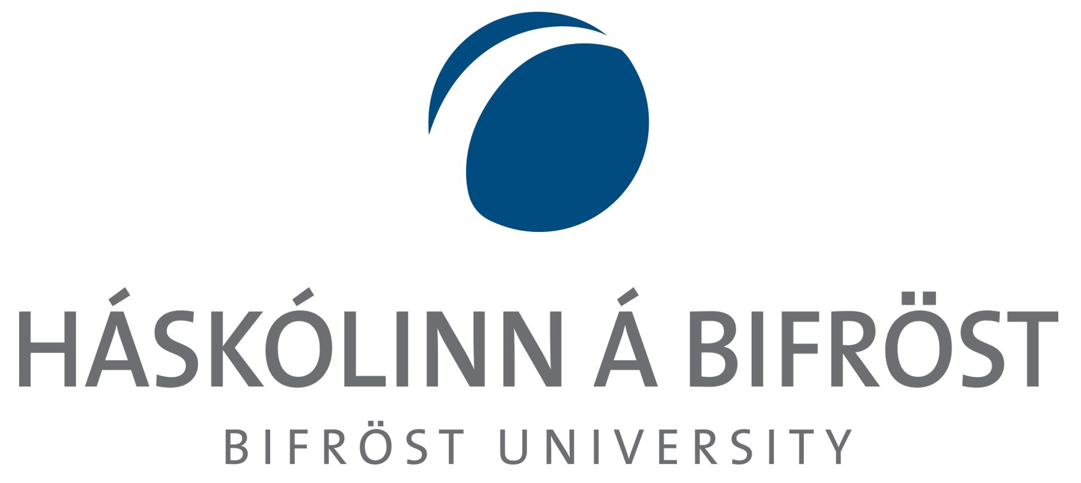

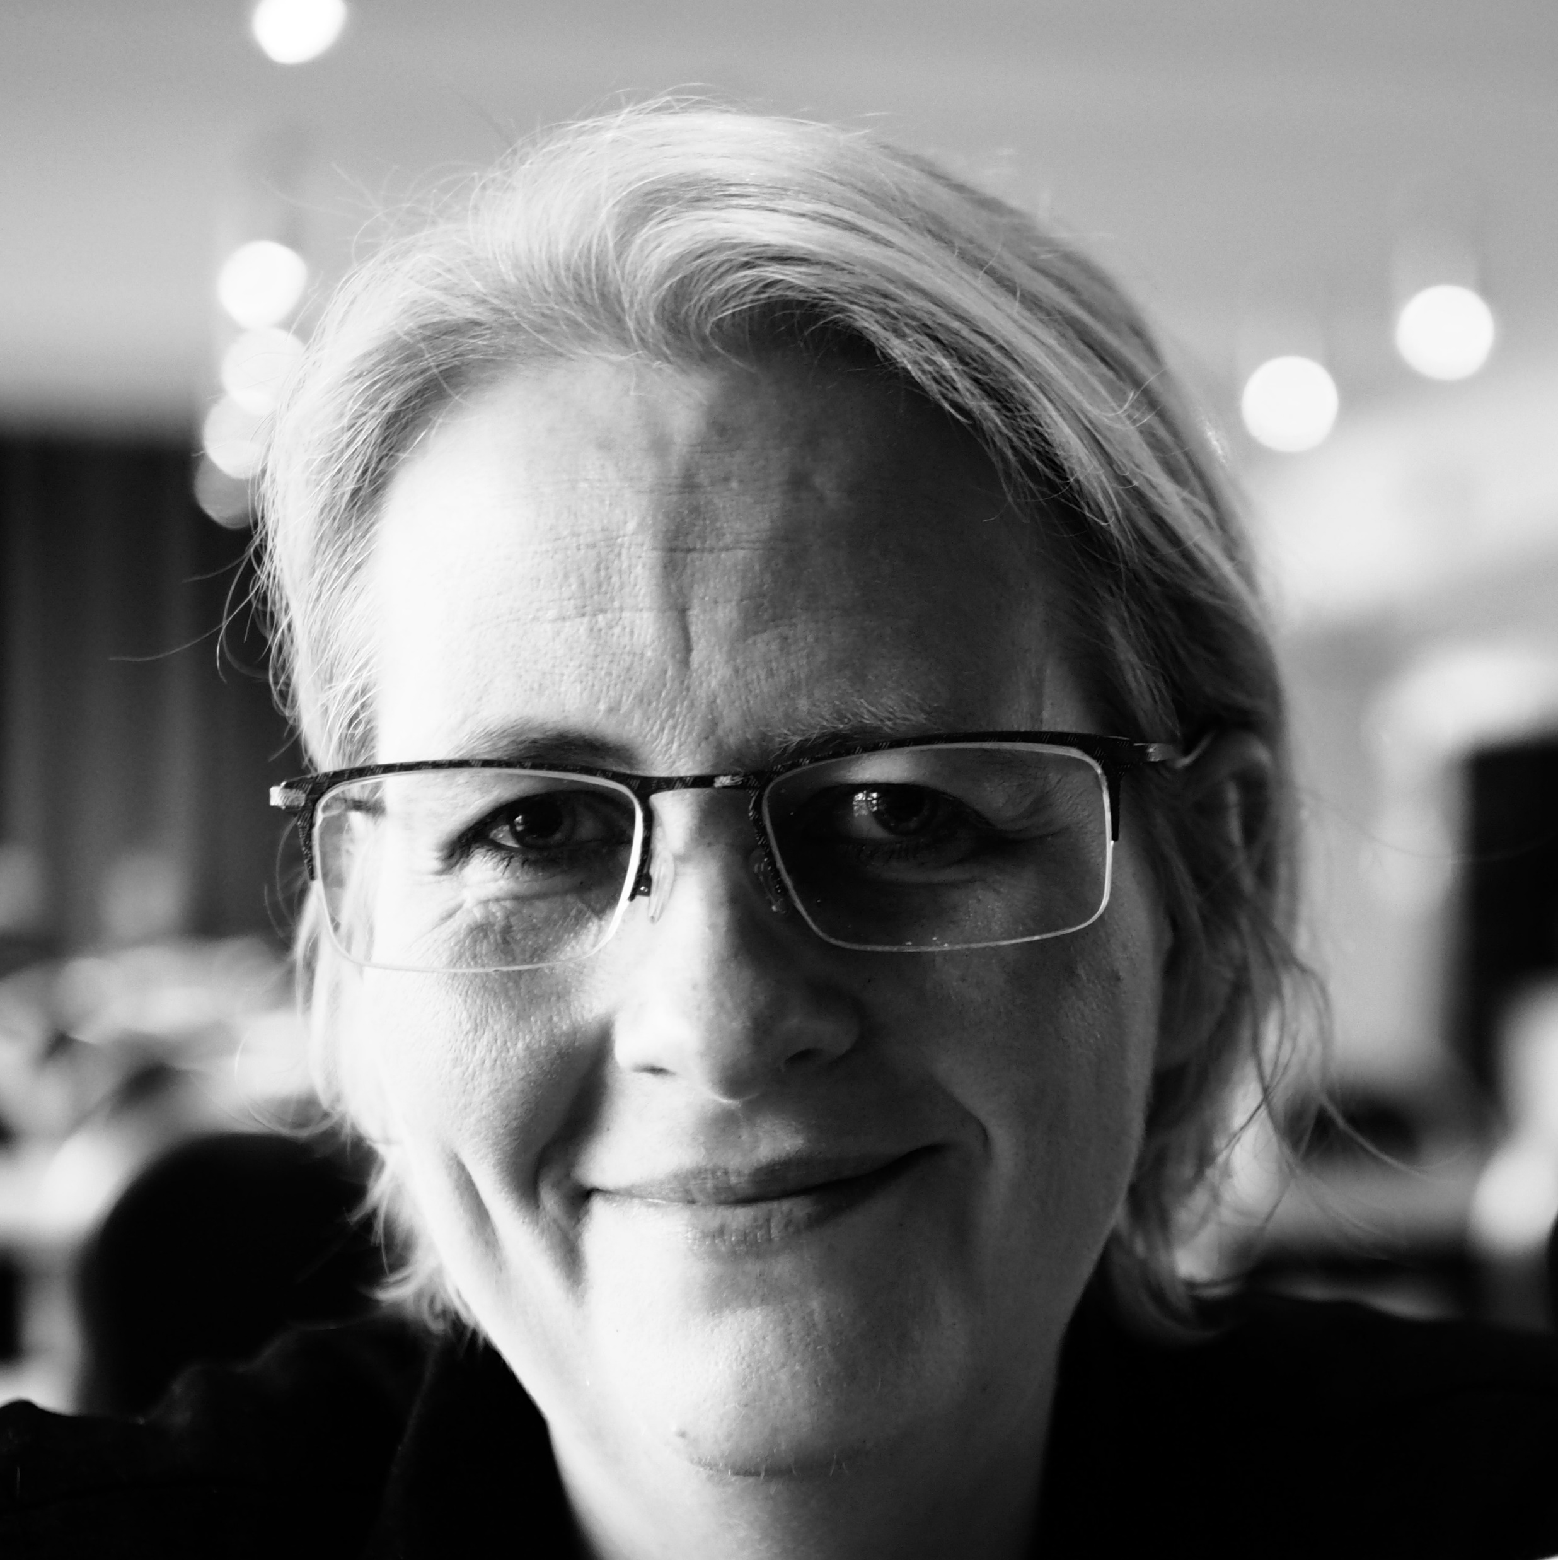
Burnout and masculine organizational culture
Stress and gender-based obstacles of women in management positions
The 13th Nordic Public Health Conference
Harpa, Reykjavik, 28th – 30th June 2022
Dr Sigrún Lilja Einarsdóttir, Associate Professor
Einar Svansson, Associate Professor
Notes:
.

Slide 2
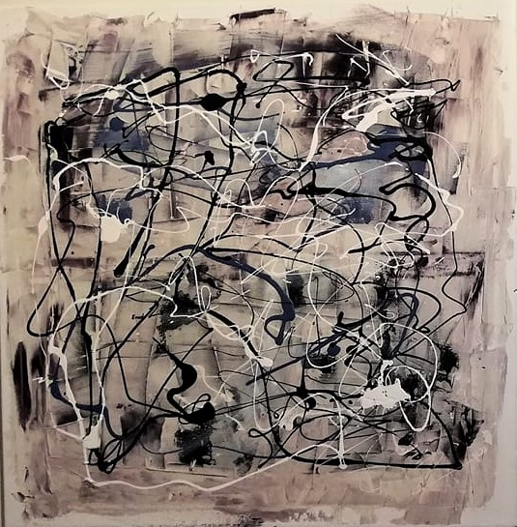
Background
Experiences of exemplary women in leadership positions in Iceland and how they cope with the corporate ladder that is more slippery for women than men (Blickenstaff, 2005; Böhmer & Schinnenburg 2018; Eagly & Carli 2007; Acker 2006; Akande 1994; Bruckmuller & Brascombe 2010; Haslam and Ryan 2008)
Women more likely than men to shoulder responsibilities in their personal life (the third shift), even if they earn more than their spouse (see for example Doyle & Hind 1998; Nelson & Burke 2000; Belyakova et al. 2017).
Valuable lessons can be drawn from how women leaders cope with stress
Notes:
Exemplary women leaders are interesting cases related to the first argument and they seem to cope with even more stress and difficult personal circumstances than men. However, women are not necessarily better “by nature” to lead than men but company culture and cultural gender discrimination makes the corporate ladder more slippery for women than men (Blickenstaff 2005; Böhmer & Schinnenburg 2018; Eagly & Carli 2007; Acker 2006; Akande 1994; Bruckmuller & Brascombe 2010; Haslam and Ryan 2008)
Women are also more likely to be in more stressful conditions by shouldering more responsibilities in their personal life than men so women in management may have developed valuable methods to cope with stressful working conditions (Doyle & Hind 1998; Nelson & Burke 2000; Belyakova et al. 2017).
The lessons, learned from the experiences of women leaders, particularly women who have accomplished unusual success as top directors in their organizations, can be valuable to highlight both negative and positive traits and behaviour of leaders. They are also important guidelines to improve management by controlling stress load and use coping techniques against burnout.
This paper reports primary findings from an Icelandic qualitative study, which observes these women‘s experiences on the way to the top and the challenges they may have faced while climbing the corporate ladder, particularly in terms of coping with stress and gender-related issues.

Slide 3

Methods
Data were collected through qualitative interviews, in this round (Oct 2019 – Feb 2020)
October 2019 – February 2020
Nine Icelandic women in leadership and management positions (who had obtained management awards), both in the public and private sector in the period
A part of a wider study among Nordic female managers,
Observes their experiences on the way to the top and the challenges they may have faced while climbing the corporate ladder
Particularly in terms of coping with stress and gender-related issues.

Slide 4
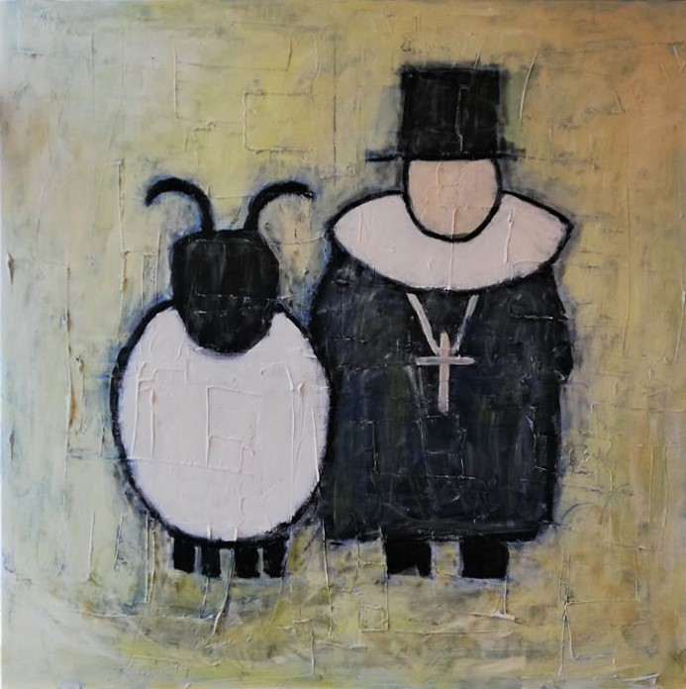
Bad experiences of toxic management styles in a male-oriented organisational culture
Participants shared a number of horror stories of some of their previous (mostly male) managers – why?
  Toxic management styles are more likely to flourish in a homogenous organisational environment (lack of equality and diversity) and are even rewarded at times (narcissicm, scandals, corruption, unethical behaviours etc)
  Top-down management can negatively influence the corporate culture and have negative effects on the empowerment of employees - nepotism, ,,looking in the mirror“ and the fear of hiring skilled employees (who are even more clever than the manager)
  Challenging working conditions, stress and constant pressure can lead to worse decision-makings and a lack of communication
  All the factors above are influential in terms of developing burnout
  (Schuh et al. 2012; Kellerman 2005; Higgs 2009; Allio 2007; Erickson et al. 2007).
Notes:
Experiences and “horror stories” of challenging work conditions due to toxic work culture are commonly heard, probably more common than stories of “excellent leadership”. In this context, there are three related arguments that are worth considering:
Firstly, toxic culture thrives particularly due to lack of diversity and equality in the workplace.
Secondly, the top-down management is still a big problem in many companies. It leads to negative corporate culture, based on power struggles and internal politics, counteractive to democratic leadership style and empowerment of employees. The first two arguments often lead to bad recruitment techniques where the best candidates for middle and top management positions are left out due to nepotism and fear of competition on the top.
The third argument refers to difficult work environment and work-related burnout because of too much pressure and stress, which can make any good manager to deteriorate in communication and decision-making. Bad leaders tend to shy away from delegating and trusting middle managers and co-workers resulting in too much workload and top-down decision making. This behaviour can lead to weaker, non-professional decision-making, tunnel vision and worse results for the organizations (Schuh et al. 2012; Kellerman 2005; Higgs 2009; Allio 2007; Erickson et al. 2007).

Slide 5
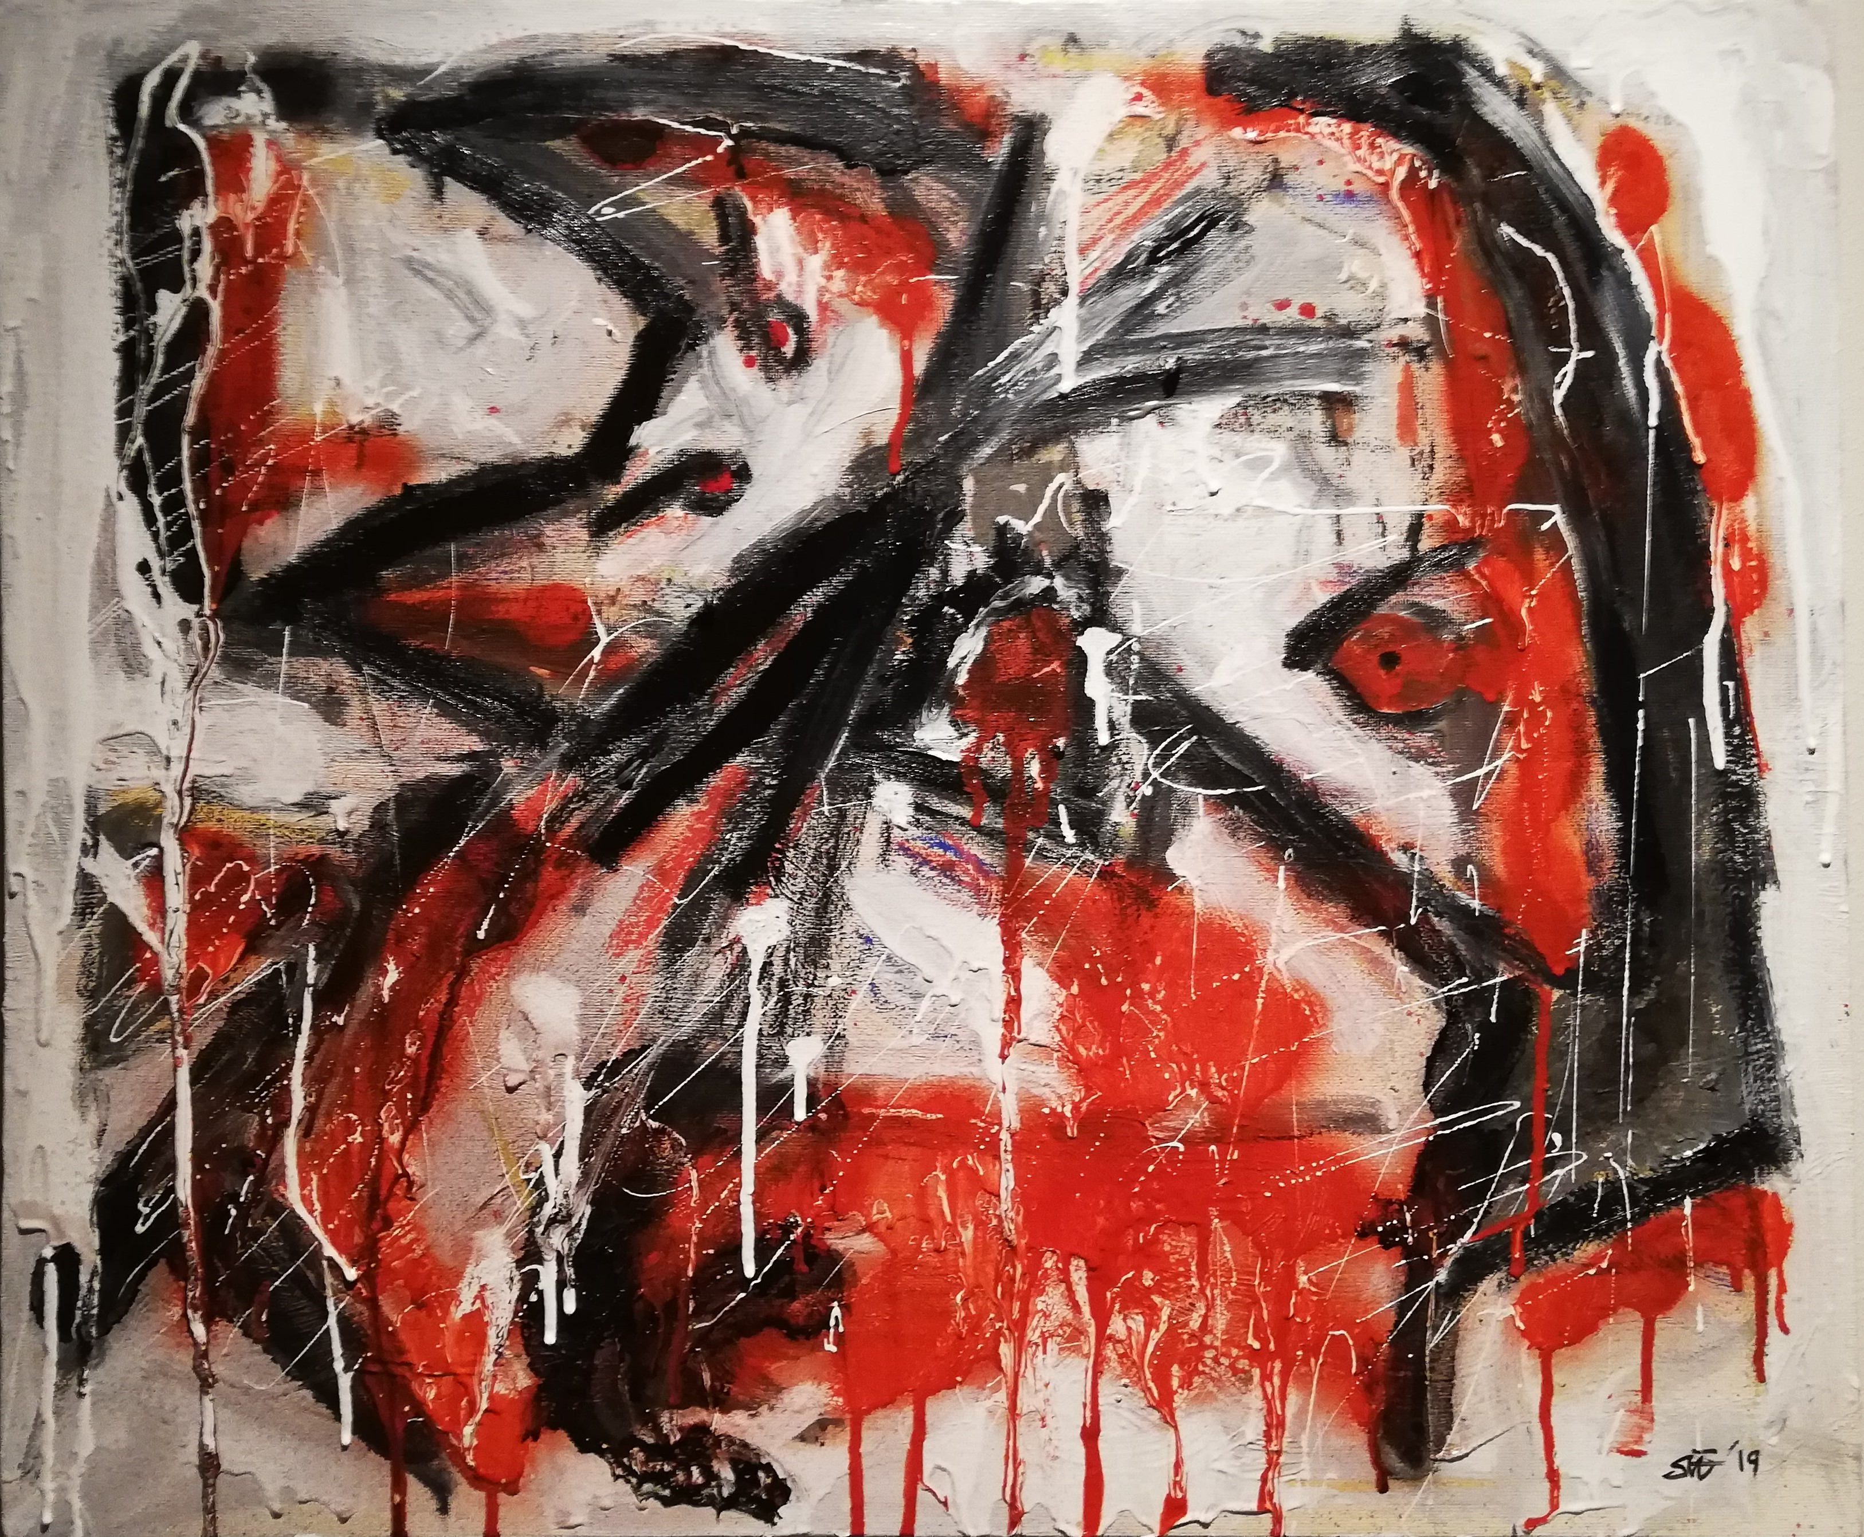
Dealing with mansplaining?
Women in management positions tend to be marginalised; either put on a pedistole or their skills and experiences questioned (Adams, 2015)
When I was young, I made speeches about how easy it is to be a woman in my sector, even though most of the time I was the only woman. That was simply because I wasn’t taking anything away from anyone. The very day I became a threat, the shit show began, when I took something someone thought belonged to him.
Yes, sometimes people want to put me down and put me in my place [laughs]. I’ve also been in the position where group of men collectively decide to deliberately misunderstand me, when it suits them to keep things unchanged.
Gender-specific emotional labour!
Notes:
Experiences and “horror stories” of challenging work conditions due to toxic work culture are commonly heard, probably more common than stories of “excellent leadership”. In this context, there are three related arguments that are worth considering:
Firstly, toxic culture thrives particularly due to lack of diversity and equality in the workplace.
Secondly, the top-down management is still a big problem in many companies. It leads to negative corporate culture, based on power struggles and internal politics, counteractive to democratic leadership style and empowerment of employees. The first two arguments often lead to bad recruitment techniques where the best candidates for middle and top management positions are left out due to nepotism and fear of competition on the top.
The third argument refers to difficult work environment and work-related burnout because of too much pressure and stress, which can make any good manager to deteriorate in communication and decision-making. Bad leaders tend to shy away from delegating and trusting middle managers and co-workers resulting in too much workload and top-down decision making. This behaviour can lead to weaker, non-professional decision-making, tunnel vision and worse results for the organizations (Schuh et al. 2012; Kellerman 2005; Higgs 2009; Allio 2007; Erickson et al. 2007).

Slide 6
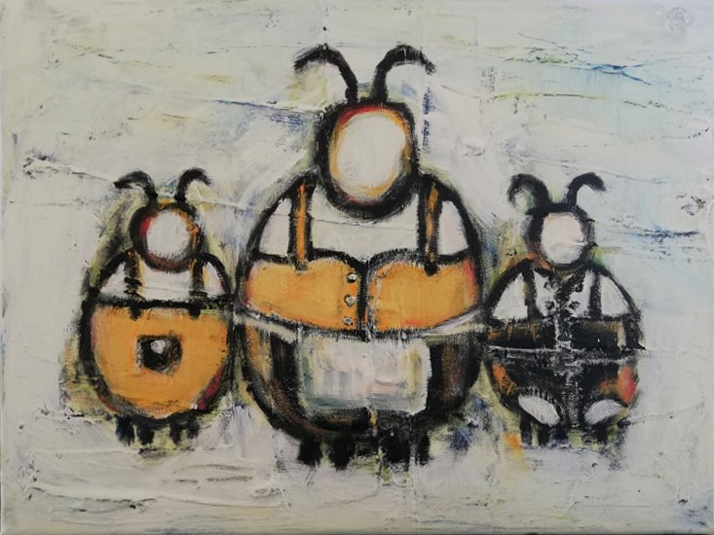
Organisational housework: Cleaning up the mess!
Men are more likely to be chosen into management positions in times of prosperity (Kanter 1977; Stroh et al. 2004)
However, if the boys have made a mess in the kitchen, it is always assumed to be a “good idea” to get a woman to clean it up!
The emphasis on women’s skills and capabilities as a “solution” and “salvation” during times of crisis can create a risk for female candidates and cause an unfair pressure on them to be the saviours of the company, to clean up after the screw-ups of their male counterparts (the glass cliff is slippery!)
(Axelsdóttir & Einarsdóttir 2017; Bruckmuller & Brascombe 2010, Haslam & Ryan 2008)
Notes:
However, if the boys in the house have made a mess in the kitchen, it is always assumed to be a “good idea” to get a woman to clean it up. The emphasis on women’s skills and capabilities as a “solution” and “salvation” during times of crisis can create a risk for female candidates and cause an unfair pressure on them to be the saviours of the company, to clean up after the screw-ups of their male counterparts (see Axelsdóttir & Einarsdóttir 2017; Bruckmuller & Brascombe 2010). Hence, studies have demonstrated that women are more likely to be chosen into management positions in times of crisis (Kanter 1977; Stroh et al. 2004), particularly when their male counterparts have made a financial mess or partaken in scandalous and/or illegal activities and someone needs to do the organisational housework and end up on the glass cliff (Bruckmuller & Brascombe 2010; Haslam & Ryan 2008). On the contrary, men are more likely to be chosen into management positions in times of prosperity. This tendency puts an increased risk on the shoulders of female leaders. Obtaining a management position in times of crisis is a certain risk for their career, plus the pressure of women expected to be better than their male counterparts. What contradicts this position is the fact that some studies (like van Esch et al. 2018) have demonstrated that hiring women in management positions is perceived more of a risk, particularly if the woman is only evaluated as “moderately qualified”. This can lead to higher levels of stress (Doyle & Hind 1998) and can increase the risk of health issues, even leading to burnout (Nelson & Burke 2000; Belyakova et al. 2017).

Slide 7
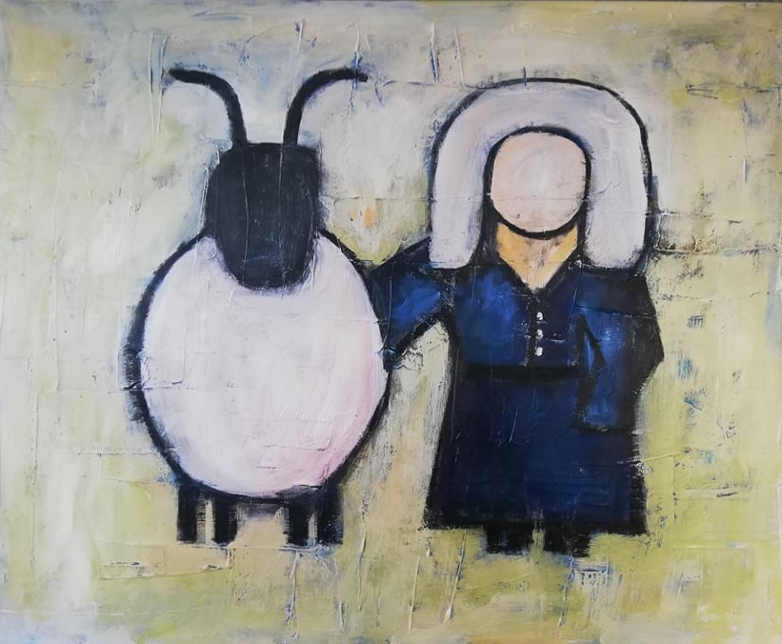
Icelandic female leaders on the issues of burnout
Burn-out as a severe cause of too much stress, pressure and overwhelming responsibility
Lack of coping mechanisms and self-care (specifically vicious for female managers, particularly when burdened with family responsibilities)
Burn-out can lead to bad management styles, bad communication patterns and the organisation as a whole could suffer, if not treated with preventive measures
Notes:
Burn-out as a result of too much workload, overwhelming responsibility and a lack of coping mechanisms and self-care (with women in a specific danger of burning out, due to more domestic responsibilities).

Slide 8
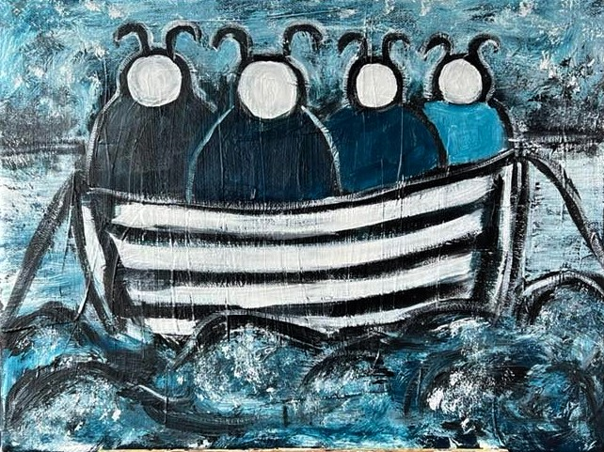
  Coping with stress
Participants emphasized the importance of trust between employees and managers and that someone had their back, both at home and in the workplace
In addition, preventive measures like healthy living and regular excercise were a common theme
I had to spend 20 years acting like a guy in a suit – laughing at all the hoarse jokes and adapt to the male oriented culture completely ... Perhaps that experience has provided me with essential skills dealing with male colleagues in meetings.
I managed stress by confiding with another person ... Sometimes through tears ... That‘s just healing, otherwise you carry it in your bones ... and you get it out of the system and thus you need to be (open) .... perhaps this is gender-based ... Because we are taught that boys don‘t cry .... But this was my healing mechanism.
Notes:
Iceland is a nation of homogeneity and relative lack of diversity. This partly reflects in the job market, specifically in the highest level of management. Interviewees had the common perspective that the emphasis should be on empowerment (power distribution) and diversity related directly to team building; using all the skills and knowledge of the workforce to enhance the organization, strengthen the individual employee and unleash hidden talents and increase job-satisfaction.
They mentioned the severe lack of diversity in terms of gender, age, nationality, and socio-economic background. One of the interviewees described the dominating patriarchy in the Icelandic job market as a kind of “promised land” (heaven), strongly guarded by men positioning themselves along the way as armed guards and gatekeepers who don’t let upstart women easily in. So, the only possibility to get in is to put their foot fast or furiously through the door and sneak or break through it (Interviewee 7). Another mentioned the frequent experience of being the only woman in meetings, specifically abroad. Her male colleagues now always bring a woman with them in meetings, “otherwise they know I comment on that and make fun of them. Some people claim that this one woman is just for show, but hey, I don’t care – she’s there, she’s at the table” (Interviewee 1).
I had to spend 20 years acting like a guy in a suit – laughing at all the hoarse jokes and adapt to the male oriented culture completely ... Perhaps that experience has provided me with essential skills dealing with male colleagues in meetings (Interviewee 1).
As evident in the above quote the more experienced interviewees talked about their experiences adapting to the male culture in their workplace, and to that experience changing their behaviours to simply fit in. This is in line with previous research, where female managers adapt certain male characteristics to survive in a male-oriented culture, shaped by power, close connections and even family relations. Some of the interviewees claimed they did not think much about being a woman in a male sector in the beginning of their careers:
When I was young, I made speeches about how easy it is to be a woman in my sector, even though most of the time I was the only woman. That was simply because I wasn’t taking anything away from anyone. The very day I became a threat, the shit show began, when I took something someone thought belonged to him ... (Interviewee 2).
Furthermore, the interviewees mentioned the tendency of male managers to look at themselves in the mirror and say hey, I like this one, let’s hire him!, preventing diversity on so many levels; “missing out on the energy and power of the young people and the wisdom and experience of the older ones” (Interviewee 5). This lack of diversity appears in managers’ reluctance of hiring women to position of power. One of the interviewees told a story about a CEO who contacted her; he wanted to hire a financial manager and claimed that this time, he wanted to hire a woman. However, despite getting many suggestions on capable female candidates, he ended up hiring a man (Interviewee 1). This storyline is in reality a part of the patriarchy dominating the corporate culture in the western world, where the tendency is to exclude talents based on race, gender and other demographic traits, who are not perceived as a part of the dominant logic.

Slide 9
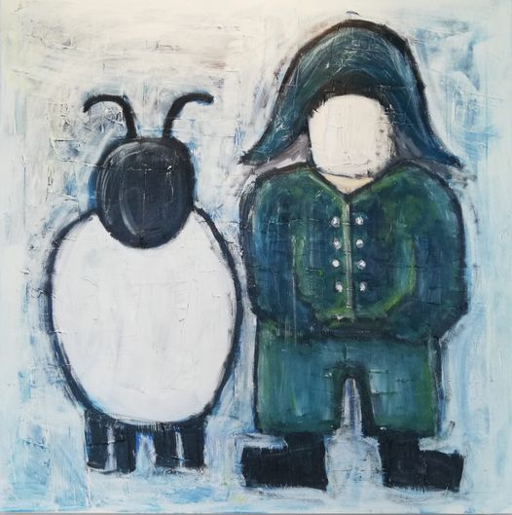
  Can burnout make a good manager a bad manager?
Negative impact of financial worries, responsibilities and workload, particularly in the start-up phase
Burnout severely effects the manager‘s abilities and leadership styles
You stop seeing things you used to see as a manager; you are not as perceptive towards people as before and you are simply in survival mode. You don’t notice how other people feel and that’s when you stop being a good leader. I was just lucky to have a person who confronted me with this when I was in this mode – of course I didn’t agree at the time but it is interesting to reflect on this afterwards and observe what I could have done better as a manager.
When manager‘s health is put at risk, the corporate culture is at risk and burn-out can lead to mistrust, lack of delegation and worse decision-making – an overall loss for the organisation, without preventive measures (Schuh et al. 2012; Kellerman 2005; Higgs 2009; Allio 2007; Erickson et al. 2007).
Notes:
Burnout was until recently ignored as a problem, like not replacing the manager temporarily with another proven manager. It is important to discuss burn-out as a recurring theme in management that needs to be addressed when it happens, in an open discussion. Just to admit that burnout is a real factor unrelated to gender and can have a big impact on company results helps to get boards of directors more open to finding a solution in time.
Findings indicated a strong tendency among the more experienced interviewees to assimilate themselves to the male culture in their corporations (see also Faniko et al. 2017) and that the glass ceiling was indeed visible until they tried to break it by pushing forward and obtain power positions, thus taking something “away” from those men who felt entitled to their promotions (see also Acker 2006; Eagly & Carli 2007).
Vast majority of the interviewees had experienced tunnel-visions, narrow-mindedness and resistance to change among their male counterparts and tendencies of old-fashioned, top-down management, arrogance and pride, where managers perceived themselves as dictators, incompetent and using old-fashioned mode of communication (or lack thereof). Most of these themes are in line with existing literature but perhaps the most noteworthy is the implications of stress and too much workload on leadership performance; unacceptable working conditions, conservative corporate culture, poor work-life initiatives and a flawed company structure can transform a good leader to demonstrate all the characteristics of a bad leader.
It is interesting to note that the main writing time of this paper took place in the middle of the 2020 Covid-19 pandemic. Discussing bad leadership among heads of state during a pandemic is a topic in itself – particularly by watching the performance of some male leaders in comparison with the performance of female heads of state, like Iceland, Norway, Denmark, Finland, Belgium, Germany and New Zealand. However, to do a full account of that topic, the pandemic must run its course to see the whole picture. Dealing with a worldwide pandemic is a masterclass in leadership and crisis management that shows all the wide variety of good and bad leadership traits and styles that have been highlighted in this paper.
e

Slide 10
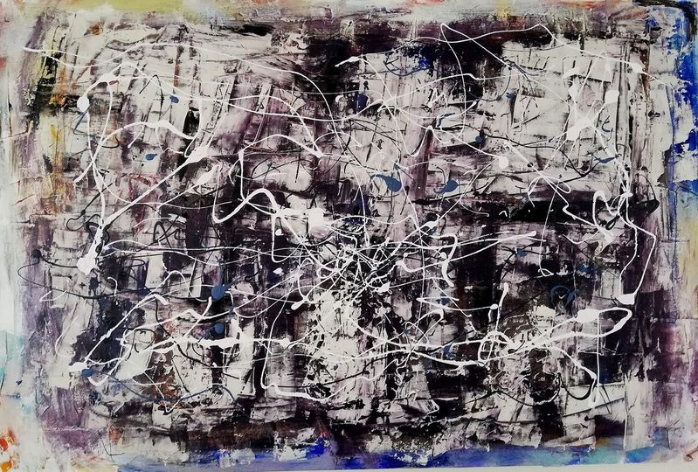
  What’s next?
Expanding to more Nordic countries
Finland is work in progress
Sweden, Denmark, Norway
Focus on burnout vs. stress
Looking deeper at coping mechanisms

Slide 11
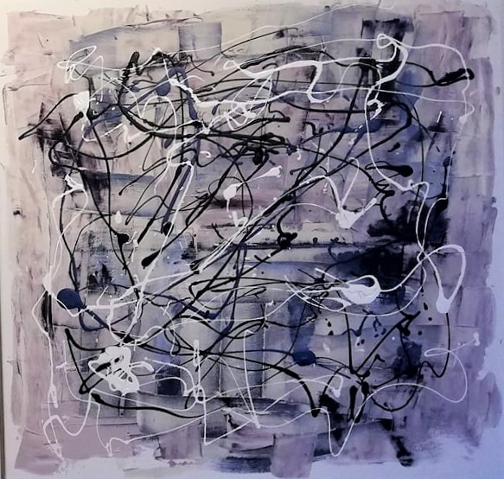
Thank you! sigrunlilja@bifrost.is einarsv@bifrost.is
Notes:
.

